Slide 1
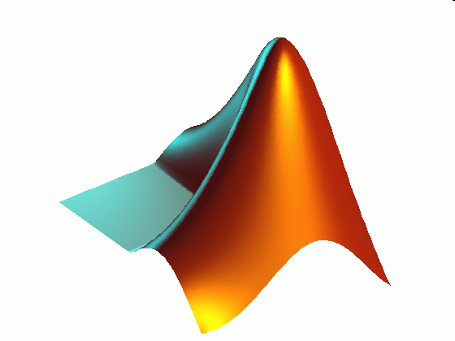
ME 203 Introduction to MATLAB
1

Slide 2
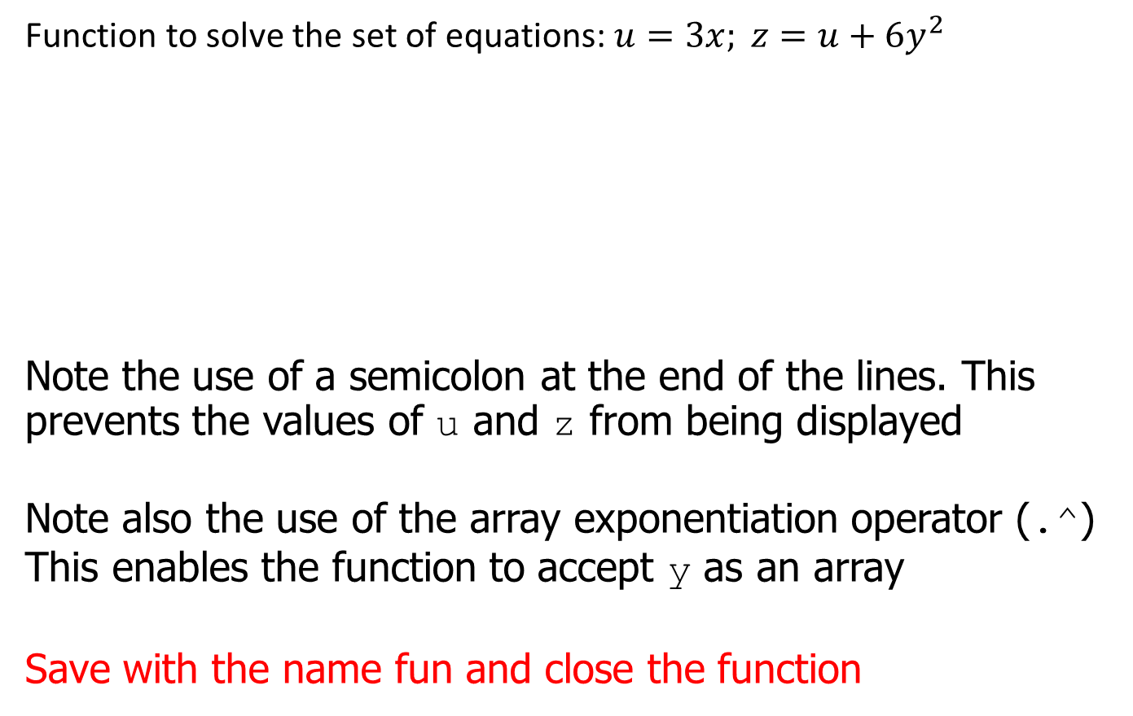
User-Defined Functions: Example
Function to solve the set of equations: $u=3x; z=u+6y^{2}$
Note the use of a semicolon at the end of the lines. This prevents the values of u and z from being displayed
Note also the use of the array exponentiation operator (.^) This enables the function to accept y as an array
Save with the name fun and close the function
function z = fun (x,y)
%Example - user defined functions
u = 3*x;
z = u +6*y.^2;
end

Slide 3
Function Handles
Function handles are a way to reference a function
You can create a function handle to any function by using the at sign, @, before the function name
You can give the handle a name if you wish, and can use the handle to reference the function

Slide 4
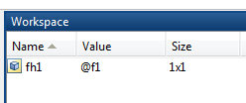
Function Handles
To create a handle to the function y = x + 2e^{−x} −3, define the following function file:
function [y] = f1( x )
y=x+2*exp(-x)-3;
end
To create a handle to f1:
>> fh1 = @f1
Function handle shows up in the Workspace just as a variable would
Name of the handle

Slide 5
Function Handles
You can pass the function as an argument to another function
For example, if you want to integrate y = x + 2e^{−x} −3 over 0 ≤ x ≤ 2:
>> integral(fh1,0,2)
ans =
-2.2707
>> integral(@f1,0,2)
ans =
-2.2707
Note: integral is a MATLAB function that numerically integrates a function within specified limits

Slide 6
Anonymous functions
Create a function without needing to create an M-file for it
Create either in command window or within another function or script
fhandle = @(arglist) expr
list of input arguments
any valid expression

Slide 7
Anonymous functions
E.g. Create a function y = x + 2e^{−x} −3
Input arguments : x
Expression : x + 2e^{-x} -3
>> fh2 = @(x) (x+2*exp(-x)-3)
fh2 =
@(x)(x+2*exp(-x)-3)
Calculate y when x=3
>> fh2(3)
ans =
0.0996

Slide 8
Anonymous functions
E.g. Create a function z = 3x + 6y²
Input arguments : x,y
Expression : 3x + 6y²
>> fh3 = @(x,y) (3*x+6*y.^2)
fh3 =
@(x,y)(3*x+6*y.^2)
Calculate z when x = 3 and y = 7
>> fh3(3,7)
ans =
303

Slide 9
Anonymous functions
E.g. Create an anonymous function with two outputs
y = x - 3
z = 3x + 6y²
Input arguments : x
Output : y, z
deal – distributes inputs to outputs
fh4 = @(x) deal(x-3, 3*x+6*(x-3).^2)
Calculate y and z when x = 5
Result
y =
2
z =
39
[y, z] = fh4(5)

Slide 10
Data Analysis
What would you want to know about the data if you took it?

Slide 11
Mean
M = mean(A)
Returns the mean values of the elements along different dimensions of an array
If A is a vector, then mean(A) returns the mean of the elements
If A is a matrix, then mean(A) returns a row vector containing the mean of each column
Ex. Calculate the mean of the first signal, data1
M=mean(data1)
M =
3.0183

Slide 12
Mean
M = mean(A,dim)
Returns the mean values for elements along the dimension of A specified by scalar dim
mean(A,1) is a row vector containing the mean of each column
mean(A,2) is a column vector containing the mean of each row

Slide 13
Mean
A =
1 2 3
3 3 6
4 6 8
4 7 7
>> mean(A,2)
ans =
2
4
6
6
>> mean(A)
ans =
3.0000 4.5000 6.0000
>> mean(mean(A))
ans =
4.5000
>> mean(A,1)
ans =
3.0000 4.5000 6.0000
Notes:
A=[1,2,3;3,3,6;4,6,8;4,7,7]

Slide 14
Maximum
max(A) Returns largest value in vector A, or the row vector of largest elements of each column in matrix A
[M,I] = max(A) Returns maximum values M and corresponding indices I of the first maximum value from each column of A
max(A,B) Returns a matrix the same size as A and B, with each element being the maximum value from the corresponding positions in A and B
max(A,[],dim) Returns the largest elements along dimension dim.
Notes:
A=[1,2,3;3,3,6;4,6,8;4,7,7]
B=[2,8,4;7,3,9]
C=[0,4,5;6,2,1]

Slide 15
Maximum Example
A =
2 8 4
7 3 9
B =
0 4 5
6 2 1
[C1,I] = max(A)
C2 = max(A,B)
C3 = max(A,[],1)
C4 = max(A,[],2)
I =
2 1 2
C1 =
7 8 9
C2 =
2 8 5
7 3 9
C3 =
7 8 9
C4 =
8
9

Slide 16
Minimum
min(A) Returns smallest value in vector A, or the row vector of smallest elements of each column in matrix A
[M,I] = min(A) Returns minimum values M and corresponding indices I of first minimum value from each column of A
min(A,B) Returns a matrix the same size as A and B, with each element being the minimum value from the corresponding positions in A and B
min(A,[],dim) Returns the largest elements along dimension dim

Slide 17
Minimum Example
A =
2 8 4
7 3 9
B =
0 4 5
6 2 1
[C1,I] = min(A)
C2 = min (A,B)
C3 = min(A,[],1)
C4 = min(A,[],2)
I =
1 2 1
C1 =
2 3 4
C2 =
0 4 4
6 2 1
C3 =
2 3 4
C4 =
2
3

Slide 18
Median, Standard Deviation and Sort
median(x) Returns the median of the elements of the vector x. Returns a row vector of the medians of the columns of matrix x.
std(x) Returns the sample standard deviation of the elements of the vector x. Returns a row vector of the sample standard deviations of the columns of matrix x.
sort(x) Returns a vector with the values of vector x in ascending order. Returns a matrix with each column of matrix x in ascending order.

Slide 19
Example
A = [1 2 3 3 3 6 4 6 8 4 7 7];
M = median(A)
d = std(A)
s1 = sort(A)
s2 = sort(A,'descend')
Results
M =
4
d =
2.2361
s1 =
1 2 3 3 3 4 4 6 6 7 7 8
s2 =
8 7 7 6 6 4 4 3 3 3 2 1
Note: sort can be used to sort strings alphabetically

Slide 20
Rounding
B = round(A) Rounds the elements of X to the nearest integers. Positive elements with a fractional part of 0.5 round up to the nearest positive integer. Negative elements with a fractional part of -0.5 round down to the nearest negative integer. For complex X, the imaginary and real parts are rounded independently.
B = fix(A) Rounds the elements of A toward zero, resulting in an array of integers.
B = ceil(A) Rounds the elements of A to the nearest integers greater than or equal to A.
B = floor(A) Rounds the elements of A to the nearest integers less than or equal to A.

Slide 21
Rounding Example
A = [-1.9, -0.2, 3.4, 5.6, 7.0]
B=round(A)
C=ceil(A)
D=fix(A)
F=floor(A)
A =
-1.9000 -0.2000 3.4000 5.6000 7.0000
B =
-2 0 3 6 7
C =
-1 0 4 6 7
D =
-1 0 3 5 7
F =
-2 -1 3 5 7

Slide 22
Sums and Products
sum(x) Returns the sum of the elements in vector x, or the row vector of the sum of elements of each column in matrix x
prod(x) Returns the product of the elements in vector x, or the row vector of the product of elements of each column in matrix x
cumsum(x) Returns a vector the same size as x containing the cumulative sum of the elements in vector x, or a matrix the same size as x containing cumulative sums of values from the columns of x
cumprod(x) Returns a vector the same size as x containing the cumulative product of the elements in vector x, or a matrix the same size as x containing cumulative products of values from the columns of x
factorial(x) Returns the product of all positive integers less than or equal to x
Notes:
A=[1,2,3,4,5];

Slide 23
Sums and Products Example
x = [2 8 4 7 3 9];
y1=sum(x)
y2=prod(x)
y3=cumsum(x)
y4=cumprod(x)
f=factorial(6)
y1 =
33
y2 =
12096
y3 =
2 10 14 21 24 33
y4 =
2 16 64 448 1344 12096
f =
720

